Slide 1
Influenza Trends for Counties in the State of Montana
Spring 2019 Data Science Projects Class
Department of Mathematical Statistics
The University of Montana-Missoula
Courtesy of University of Montana, 2019

Slide 2
Executive Summary
OBJECTIVE: Provide a tool for forecasting influenza cases (by Montana county) to the Department of Public Health and the Montana Department of Health and Human Services (DPHHS)
DATA: Evaluate weekly flu counts provided by DPHHS for indicator variables.
METHODS: Manage data, design analytical forecasting models, test forecasting accuracy and present results in teams.
RESULTS/NEXT STEPS: Assess various models’ efficacy for the goal of providing forecasting of a specified number of weeks, based on historical data. Identify future steps to determine most actionable recommendations.

Slide 3
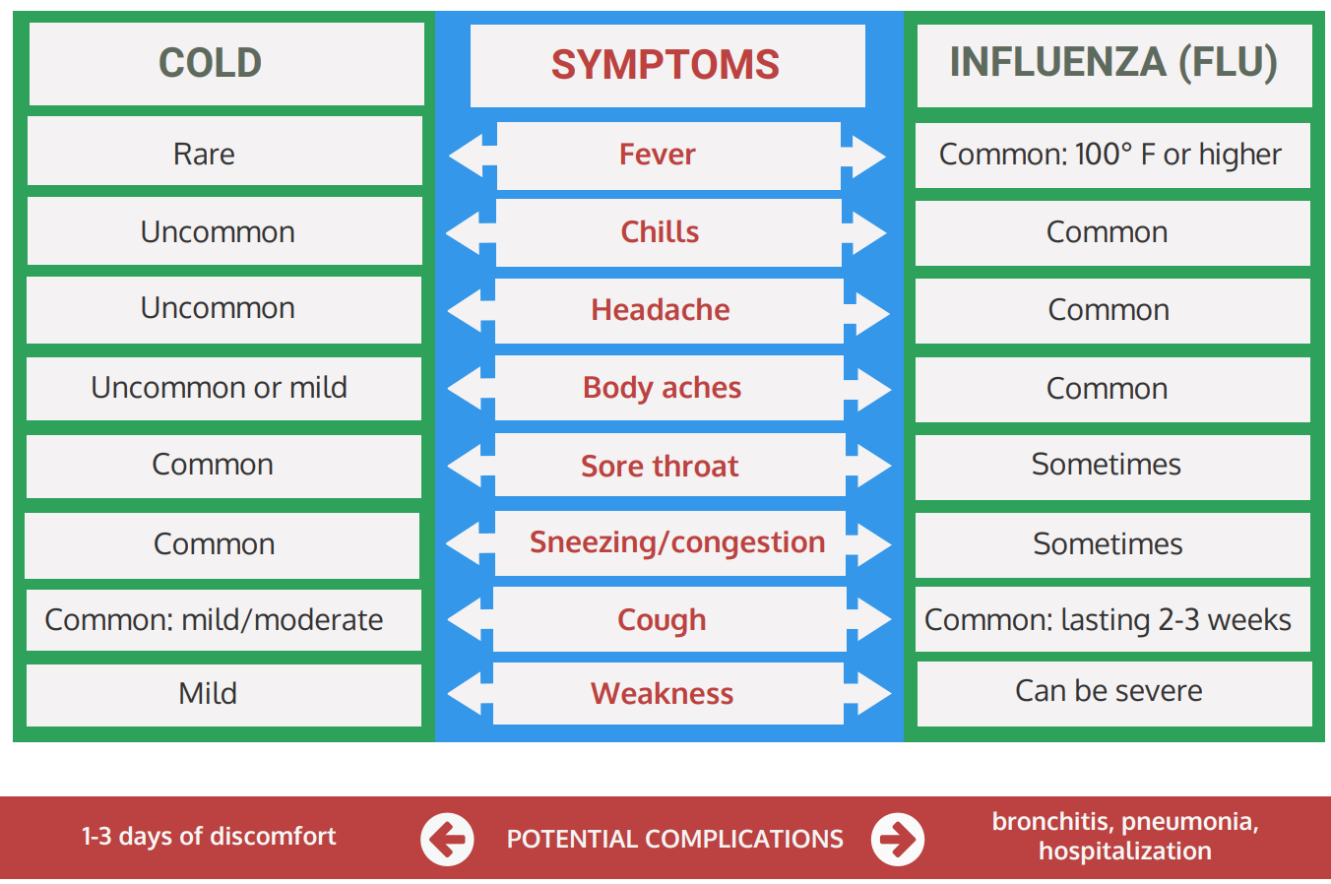
Influenza (Flu) vs Cold
Courtesy of Montana Department of Public Heath and Human Services, 2019
Notes:
Symptoms of influenza
o
Fever, headache, muscle pain, fatigue
•
Cases of flu
o
200,000 each year in United States
o
2,905 per 100,000 deaths
o
979 per 100,000 influenza associated hospitalizations in MT for 2017
-
2018
o
79 reported deaths during that year
•
Influenza activity
o
Starts September or October, peaks between December and March, lasts as late as
May

Slide 4
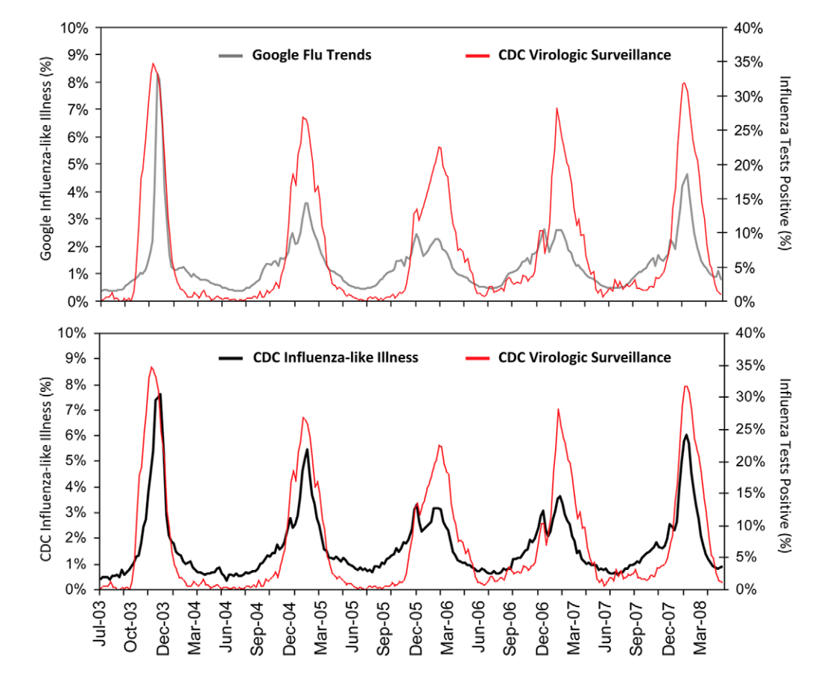
Flu Seasonality
Google Flu Trends and CDC Influenza-like illness are compared to Virologic Surveillance
X-axis represents the month and year of Influenza tests
Y-axis represents the percent of test results
Seasons for influenza with start and end months for each season
Courtesy of Ortiz, 2011

Slide 5
Data Sources
Vaccination
Environmental Factors
PM2.5
Spatial Units
Transportation
Previous Flu Season
Courtesy of Montana Department of Transportation, 2019

Slide 6
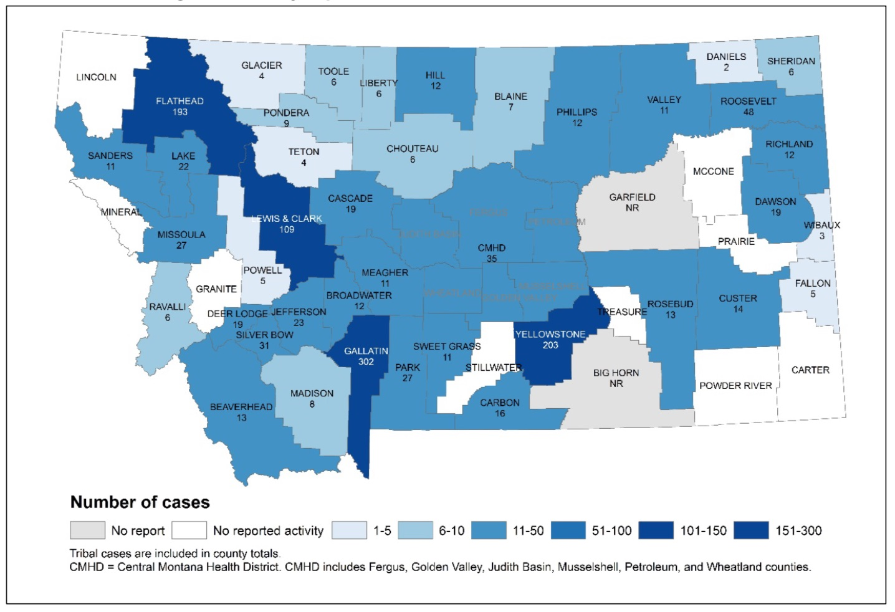
Data Staging
Courtesy of Montana Department of Public Health and Human Services (DPHHS), 2019

Slide 7
Methods: Forecasting Methods
Forecasting Plan
Software
Communication Software
Python as Programming Language

Slide 8
Forecasting Algorithms
Linear Regression
K-Nearest Neighbors
Holt-Winters
ARIMA Model

Slide 9
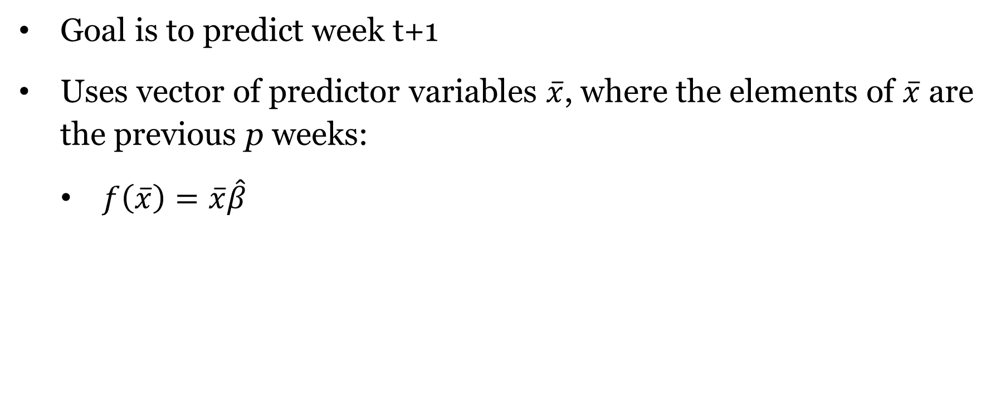
Linear Regression
Goal is to predict week t+1
Uses vector of predictor variables $\overline{x}$, where the elements of $\overline{x}$ are the previous p weeks:
$f\left(\overline{x}\right)=\overline{x}\hat{β}$

Slide 10
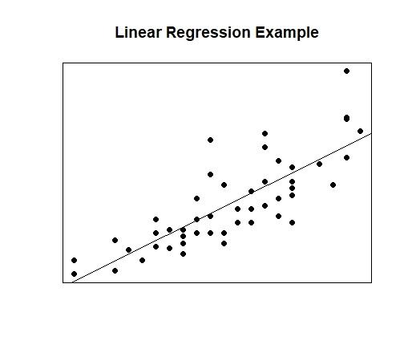
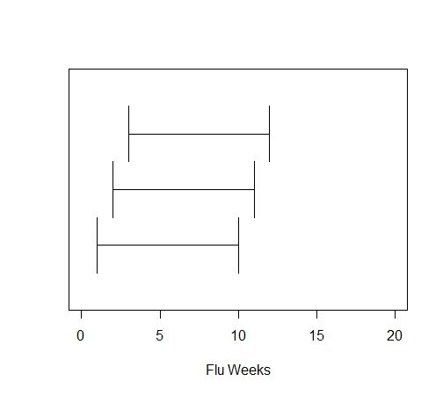
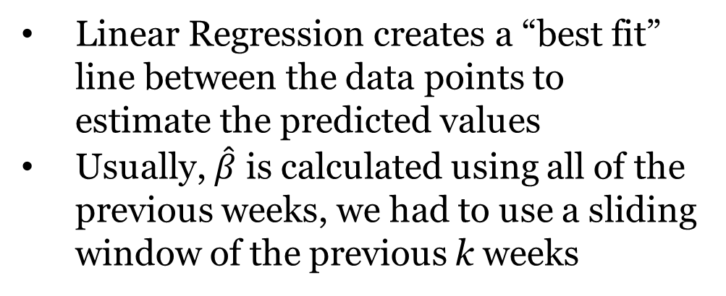
Linear Regression
Linear Regression creates a “best fit” line between the data points to estimate the predicted values
Usually, $\hat{β}$ is calculated using all of the previous weeks, we had to use a sliding window of the previous k weeks
Courtesy of Google Images

Slide 11
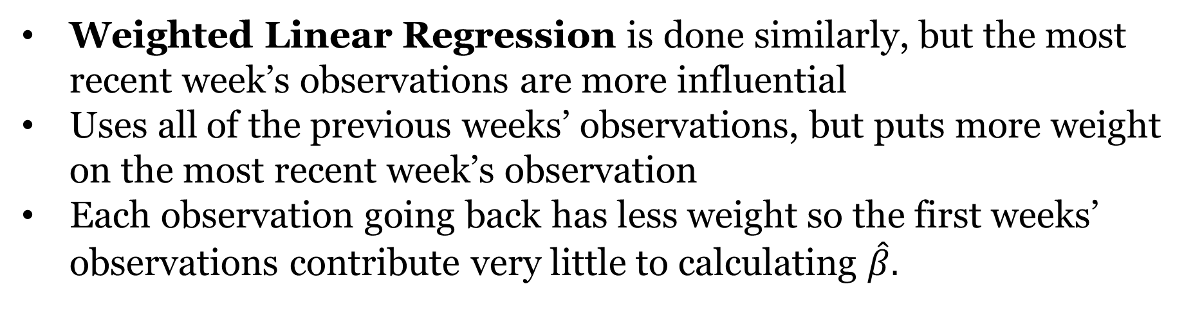
Weighted Linear Regression
Weighted Linear Regression is done similarly, but the most recent week’s observations are more influential
Uses all of the previous weeks’ observations, but puts more weight on the most recent week’s observation
Each observation going back has less weight so the first weeks’ observations contribute very little to calculating $\hat{β}.$

Slide 12
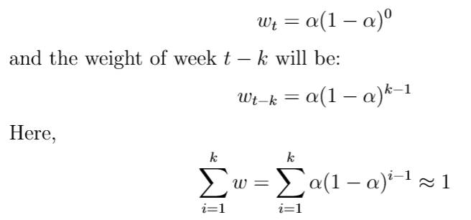
K-Nearest Neighbors Functions
Goal: To predict week t+1
Weight for week t flu counts:
Notes:
$$\text{K} \text{Nearest} \text{Neighbors}$$

Slide 13
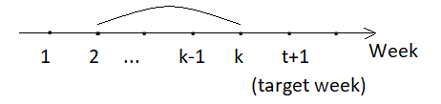
K-Nearest Neighbors Conventional
Thus, the predicted flu counts for week t+1:
If k<t, then we call it K-Nearest Neighbors Conventional Function:
To predict week 2 through week k, we assign weights for week 1 through week k-1
Notes:
K Nearest Neighbors

Slide 14
K-Nearest Neighbors Exponential
If k=t, then we call it K-Nearest Neighbors Exponential Function, that is, we use all previous t weeks to predict week t+1.
Notes:
K Nearest Neighbors

Slide 15
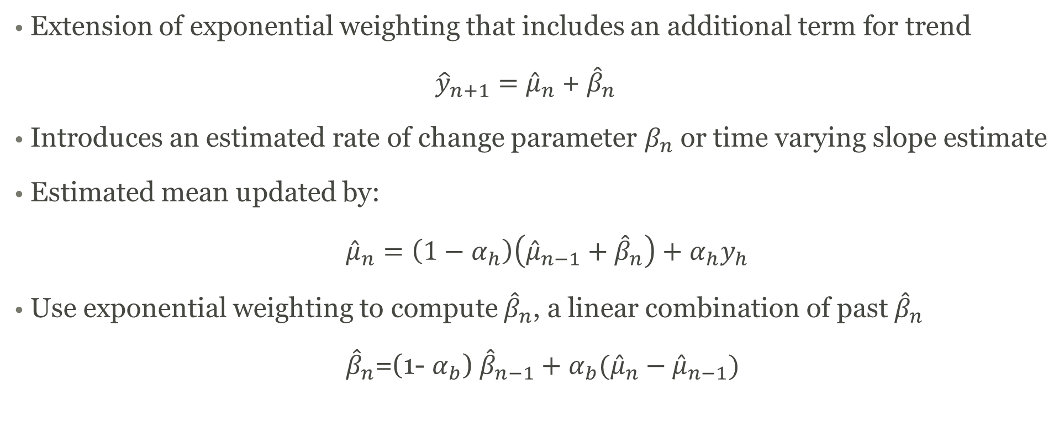
Holt-Winters
Extension of exponential weighting that includes an additional term for trend
${\hat{y}}_{n+1}=$ ${\hat{μ}}_{n}$ + ${\hat{β}}_{n}$
Introduces an estimated rate of change parameter $β_{n}$ or time varying slope estimate
Estimated mean updated by:
${\hat{μ}}_{n}=\left(1−α_{h}\right)\left({\hat{μ}}_{n−1}+{\hat{β}}_{n}\right)+α_{h}y_{h}$
Use exponential weighting to compute ${\hat{β}}_{n}$, a linear combination of past ${\hat{β}}_{n}$
${\hat{β}}_{n}$=(1- $α_{b}$) ${\hat{β}}_{n−1}+$ $α_{b}({\hat{μ}}_{n}−{\hat{μ}}_{n−1})$
Notes:
K Nearest Neighbors

Slide 16
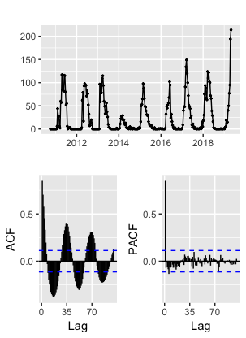
ARIMA Model
Arima modeling combines three components
Auto regression, Moving averages, and differencing
Often used with Economic data
Great for seasonal parameters
Difficulties in seasonality, stationarity, automation
Notes:
K Nearest Neighbors

Slide 17
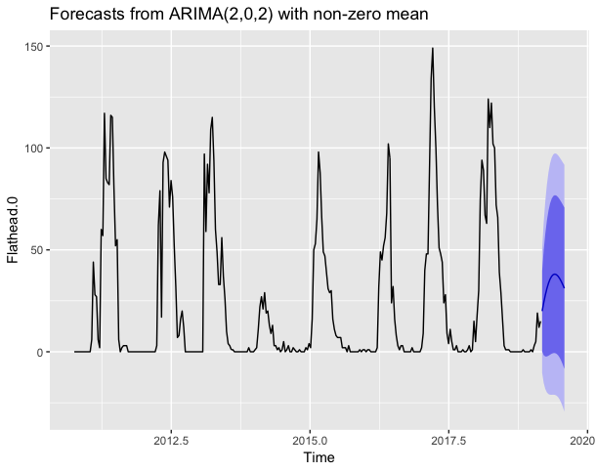
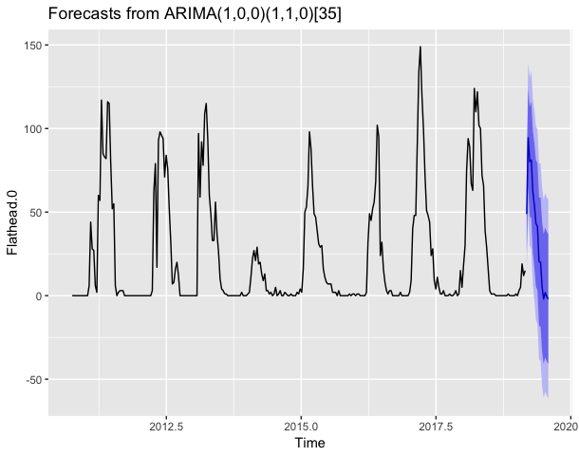
ARIMA Model
Notes:
K Nearest Neighbors

Slide 18
Forecasting Summary
Results in CSV files.
Results in python object.

Slide 19
Accuracy Assessment Methods
R² – Coefficient of Determination
Compares the sum of squared errors produced by the prediction/forecasting function to the sum of squared errors produced by a baseline prediction function
RMSE – Root-Mean Square Error
Measure of the difference between values (sample or population values) predicted by a model or an estimator and the values observed
MAE – Mean Absolute Error
Measure of difference between two continuous variables

Slide 20
Threshold of Accuracy – “Good” versus “Bad” model
Coefficient of Determination
Chose R² as 0.80
Courtesy of Google Images, 2019

Slide 21
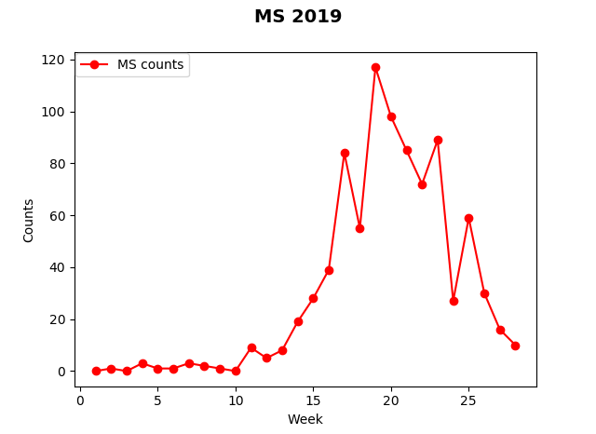
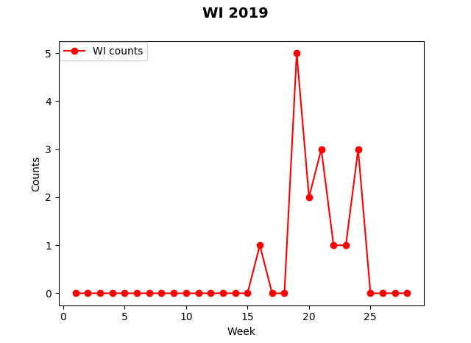
Influenza Counts by Montana Counties
Flu counts for Missoula and Wibaux counties. The x-axis represents the week of the 2018-2019 flu season and the y-axis represents the flu counts.

Slide 22
Exponential K-Nearest Neighbors
Average R² across all counties is 0.07
Average R² across large counties is 0.27
MAE is 20.45
RMSE is 42.86

Slide 23
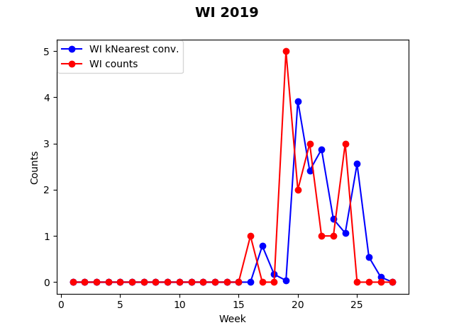
Conventional K-Nearest Neighbors (K=3)
Average R² across all counties is 0.09
Average R² across large counties is 0.57
MAE is 16.32
RMSE is 28.08

Slide 24
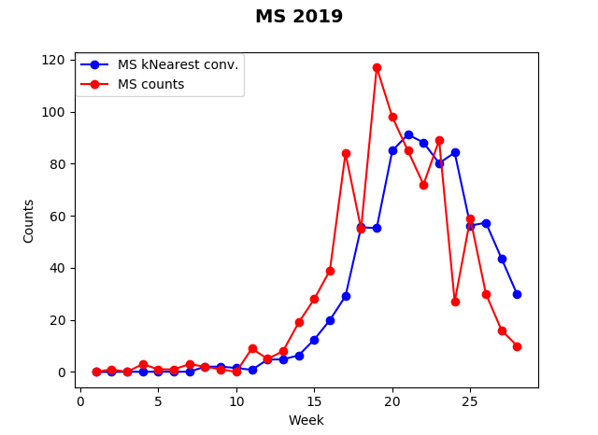
Conventional K-Nearest Neighbors (K=7)
Average R² across all counties is 0.15
Average R² across large counties is 0.51
MAE is 17.35
RMSE is 32.09

Slide 25
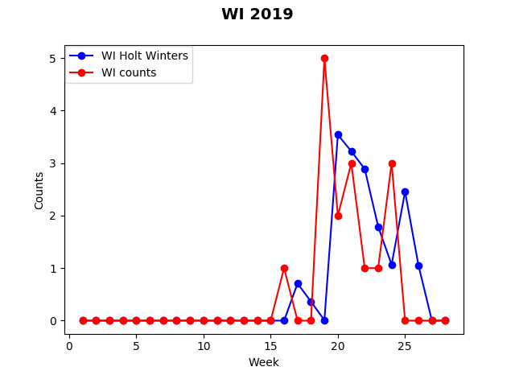
Holt-Winters Forecasting (0.35, 0.05)
Average R² across all counties is 0.05
Average R² across large counties is 0.53
MAE is 17.03
RMSE is 29.64

Slide 26
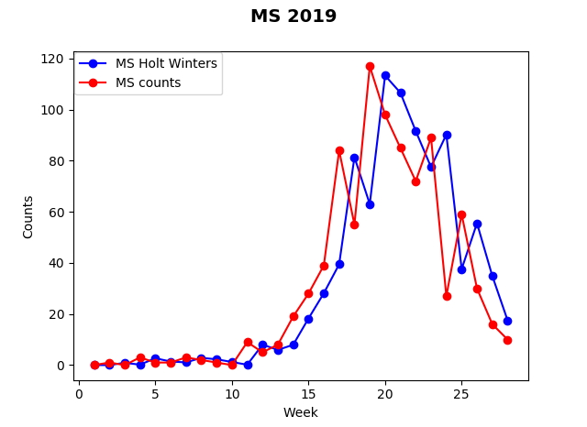
Holt-Winters Forecasting (0.70, 0.05)
Average R² across all counties is 0.02
Average R² across large counties is 0.55
MAE is 16.78
RMSE is 28.62

Slide 27
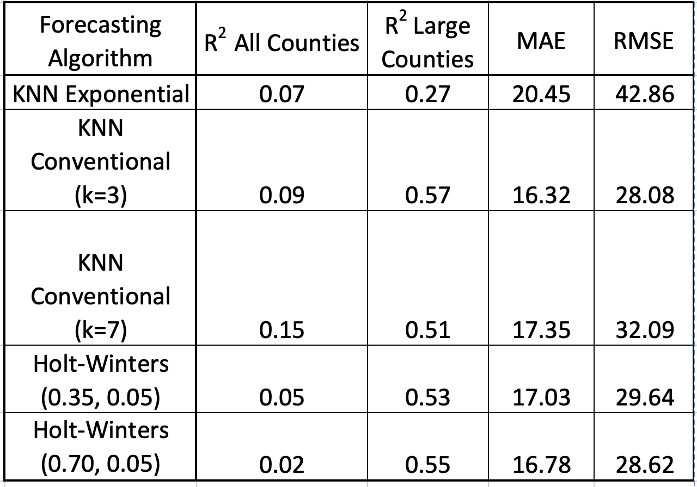
Results
Use KNN Conventional (k=3) for large counties
Use KNN Conventional (k=7) for all counties

Slide 28
Conclusion
The use of our selected techniques on historical weekly flu incidents provided varying degrees of statistical value, with the greatest distinction being between large-population counties and the average.
A “one size fits all” recommendation for forecasting flu across all Montana counties based on these methodologies is unlikely to provide optimal results, but rather a launching pad for additional analysis.
A continuing effort that allows for more complex statistical models coupled with additional sources of relevant data (vaccination information, air particulates/currents, human transportation corridors, etc.) is expected to provide opportunities for a more actionable, composite recommendation.

Slide 29
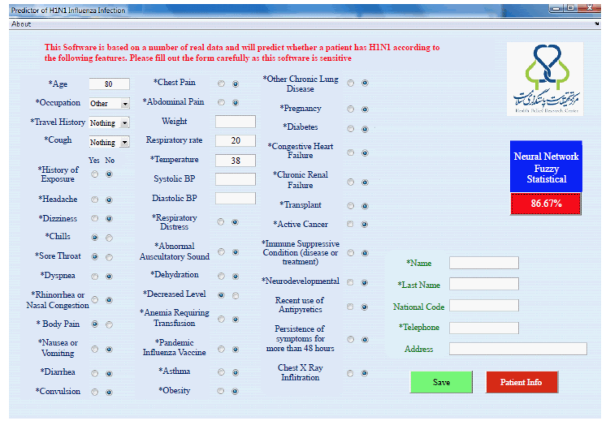
Future Work
Create a graphical user interface (GUI)
Improve forecasting algorithms
Automate data staging
Extend to other diseases
Courtesy of Boostani, R., et al., 2012
Notes:
Develop algorithms to forecast from 1 week ahead to 4 weeks ahead
Reduce forecasting error
Forecasts, accuracy assessments and plots for forecasts

Slide 30
Questions?
Courtesy of Google Images, 2019

Slide 31
References
Boostani, R., Rismanchi, M., Khosravani, A., Rashidi, L., Kouchaki, S., et al. (2012).
Presenting a Hybrid Method in Order to Predict the 2009 Pandemic Influenza A (H1N1). Journal of Health & Medical Informatics, 3(3), 1-6.
Center of Disease Control and Prevention. (2019). Weekly U.S. Influenza Surveillance Report. Retrieved from https://www.cdc.gov.flu/weekly
Hyndam, R. J., & Athanasopoulos, G. (2018). Forecasting: Principles and Practice, 2nd edition, Otexts: Melbourne, Australia.
Montana Department of Public Health and Human Services. (2019). Seasonal Influenza
(Flu). Retrieved from https://dphhs.mt.gov/publichealth/cdepi/diseases/influenza.
Ortiz, J. R., Zhou, H., Shay, D. K., Neuzil, K. M., Fowlkes, A. L., et al. (2011). Monitoring
Influenza Activity in the United States: A Comparisons of Traditional Surveillance
Systems with Google Flu Trends. PLoS ONE, 6(4), 1-10.
Steele, B., Chandler, J., & Reddy, S. (2016). Algorithms for Data Science. Cham,
Switzerland: Springer International Publishing.
United States Environmental Protection Agency. (2019). Particulate Matter (PM) Basics.
Retrieved from https://www.epa.gov/pm-pollution/particulate-matter-pm-basics#PM.
Zachary, K. C. (2019). Treatment of Influenza in Adults. Wolters Kluwer, 1(1), 1-33.

